Slide 1

PATH TO AI
Technology is the sum of techniques, skills, methods, and processes used in the production of goods or services or in the accomplishment of objectives, such as scientific investigation. Technology can be the knowledge of techniques, processes, and the like, or it can be embedded in machines to allow for operation without detailed knowledge of their workings. Systems applying technology by taking an input, changing it according to the system's use, and then producing an outcome are referred to as technology systems or technological systems.
Notes:
QuickStarter has created an outline to help you get started on your presentation. Some slides include information here in the notes to provide additional topics for you to research.

Slide 2

Data is the new OIL
Notes:
Consider talking about:
Technicism
Optimism
Skepticism and critics
Appropriate technology
Optimism and skepticism in the 21st century
Complex technological systems

Slide 3
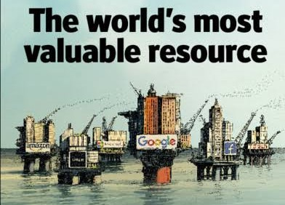

Slide 4

Source

Slide 5

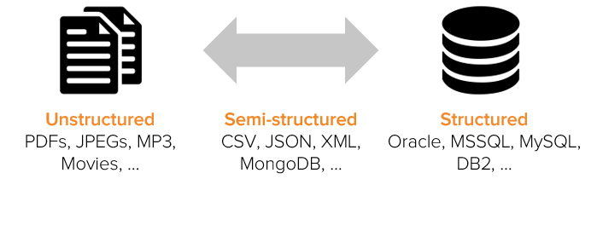

Slide 6
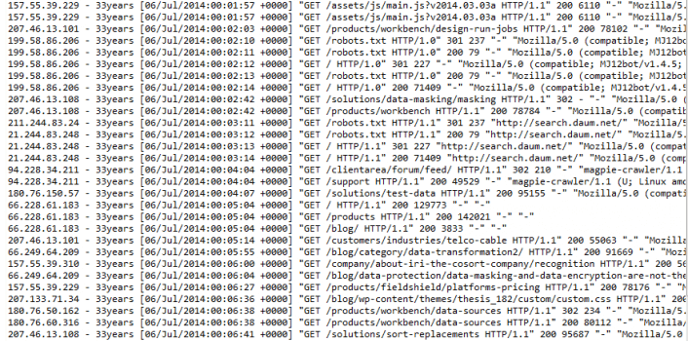

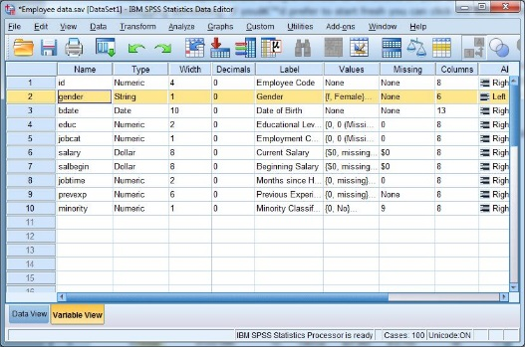
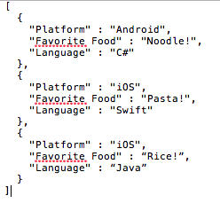
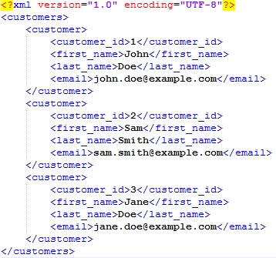
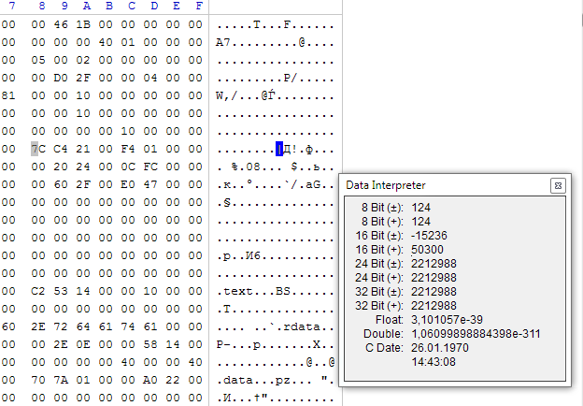
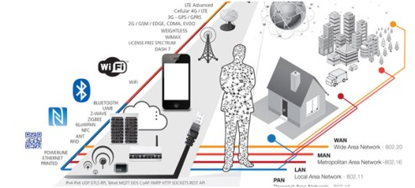
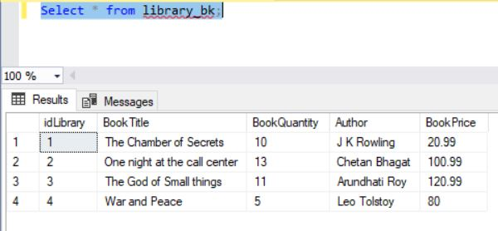
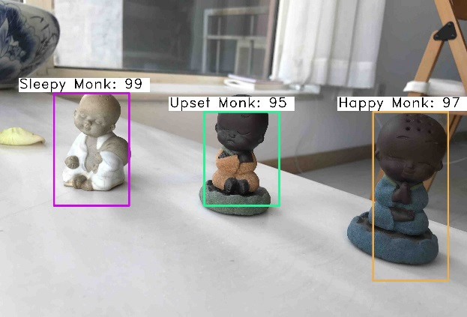

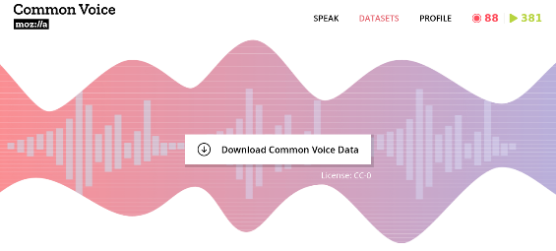
Data looks like:

Slide 7
Process

Slide 8
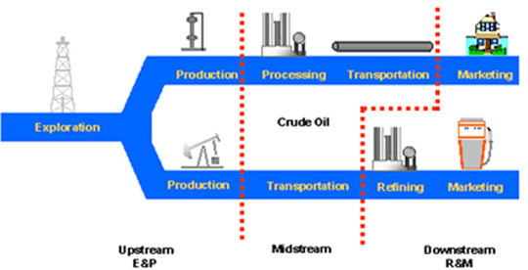
Oil value chain

Slide 9


Slide 10
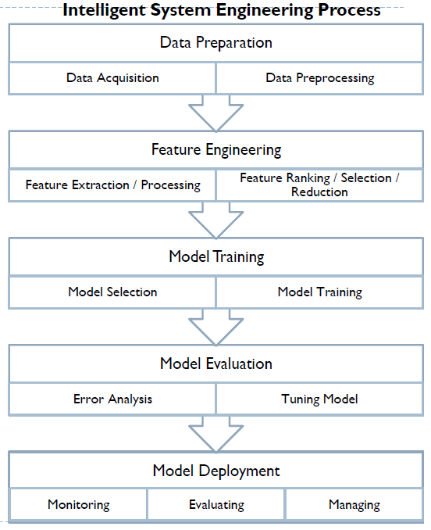

Slide 11
Products

Slide 12
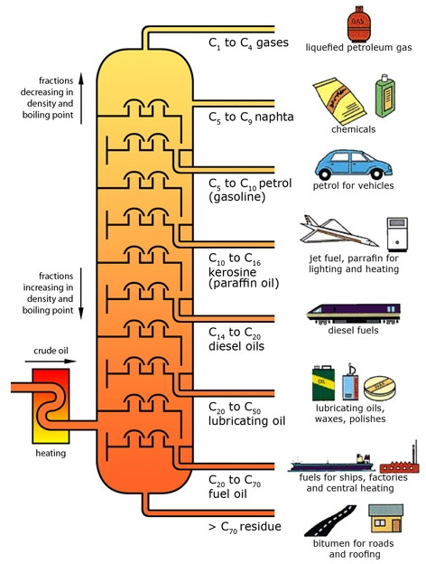
Oil value chain

Slide 13
